Slide 1
STADIUM SEAT BOOKING SYSTEM
COMPUTATIONAL THINKING FOR OBJECT-ORIENTED DESIGN
COURSE CODE: 23SC1203
[The stadium seat booking system uses Java to streamline the ticketing process, improve customer experience, and increase efficiency for both customers and stadium staff ]

Slide 2
TABLE OF CONTENTS
Abstract
Class diagram
Code
Execution
Project Report

Slide 3
TEAM MEMBERS
2320040025 CH SRIYOSHIJA
2320030285 G RUESHIKESH REDDY
2320030078 M SREE VATHSAV
2320040125 B MEGHANA SREE
2320040120 K ANVITHA REDDY

Slide 4
ABSTRACT

Slide 5
Stadium Seat Booking System
This project is dedicated to revolutionizing the stadium seat booking process by tackling the issue of efficient seat allocation. Leveraging the power of Java programming, the project aims to develop advanced algorithms that intelligently assign seats based on user preferences, seat availability, and specific constraints.
By implementing cutting-edge seat allocation strategies, this project strives to enhance the overall user experience and optimize the booking process in stadium settings.
The project's primary focus is on creating a robust and user-friendly system that simplifies the seat selection process for customers while maximizing the utilization of available seating capacity. Through the integration of innovative algorithms and data structures, the system will be able to efficiently allocate seats in real-time, taking into account factors such as group bookings, seat preferences, and seating constraints.
Furthermore, the project will prioritize scalability and performance to ensure seamless operation during peak booking periods. By incorporating features such as dynamic seat mapping and intelligent seat recommendation systems, the project aims to provide a personalized and efficient booking experience for users.

Slide 6
Key features
[1] Seat Availability:
The system updates seat availability, indicating which seats are already booked and which are still available for selection.
[2] Booking Process:
Once users have selected their desired seats, they can proceed to the booking process.
[3] Seat Reservation Management:
This includes the option to cancel a booking if needed, freeing up the seats for other users to book.
[4] Seat Release:
If a user cancels a booking, the system should automatically release the reserved seats back into the available pool for other users to book. This ensures that seats are efficiently utilized and not left unoccupied.

Slide 7
Concepts and Functionalities
Concepts:
Object-oriented programming: The SeatBookingSystem class is an example of object-oriented programming in Java, where the class encapsulates data (seat array) and methods (bookSeat, cancelBooking, isValidSeat) to manipulate the data.
Arrays: The seat array is a two-dimensional array used to represent the seating arrangement. It stores boolean values to indicate whether a seat is booked or not.
Input/output handling: The Scanner class is used to handle user input from the console. The program prompts the user for input and reads the user's choices and seat numbers.

Slide 8
Functionalities:
Booking a seat: The user can choose to book a seat by entering the row and seat number. The program checks if the seat is available and books it if it is free.
Canceling a booking: The user can choose to cancel a booking by entering the row and seat number. The program checks if the seat is booked and cancels the booking if it is reserved.
Validating seat numbers: The program validates the entered row and seat numbers to ensure they are within the valid range (1-10).
Exiting the program: The user can choose to exit the program by entering 'exit', which breaks out of the while loop and closes the Scanner object.
Error handling: The program provides error messages for invalid input and prompts the user to try again. It ensures that the user enters valid input for booking, canceling, or exiting

Slide 9
CLASS DIAGRAM

Slide 10
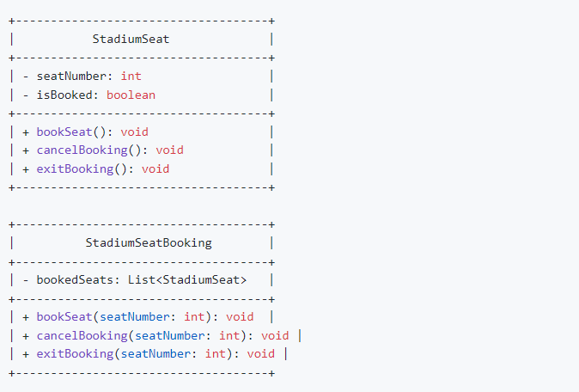

Slide 11
CODE

Slide 12
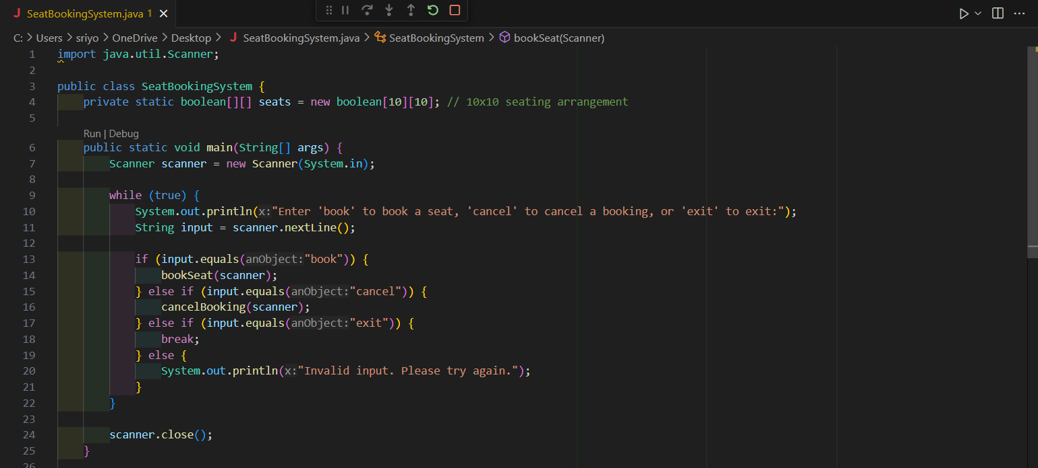

Slide 13
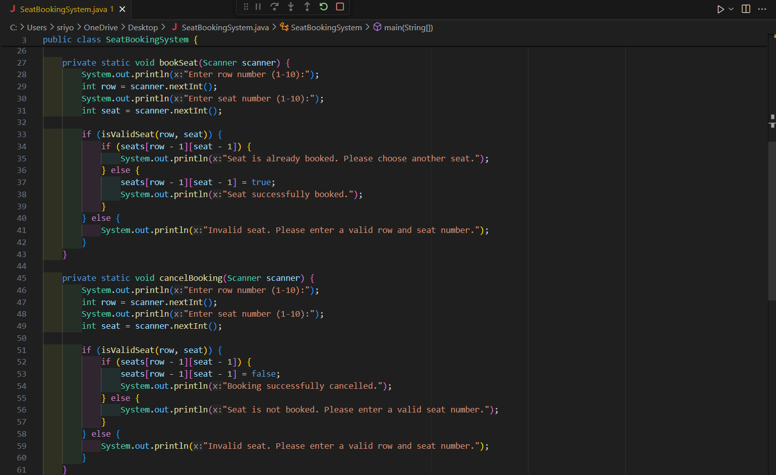

Slide 14
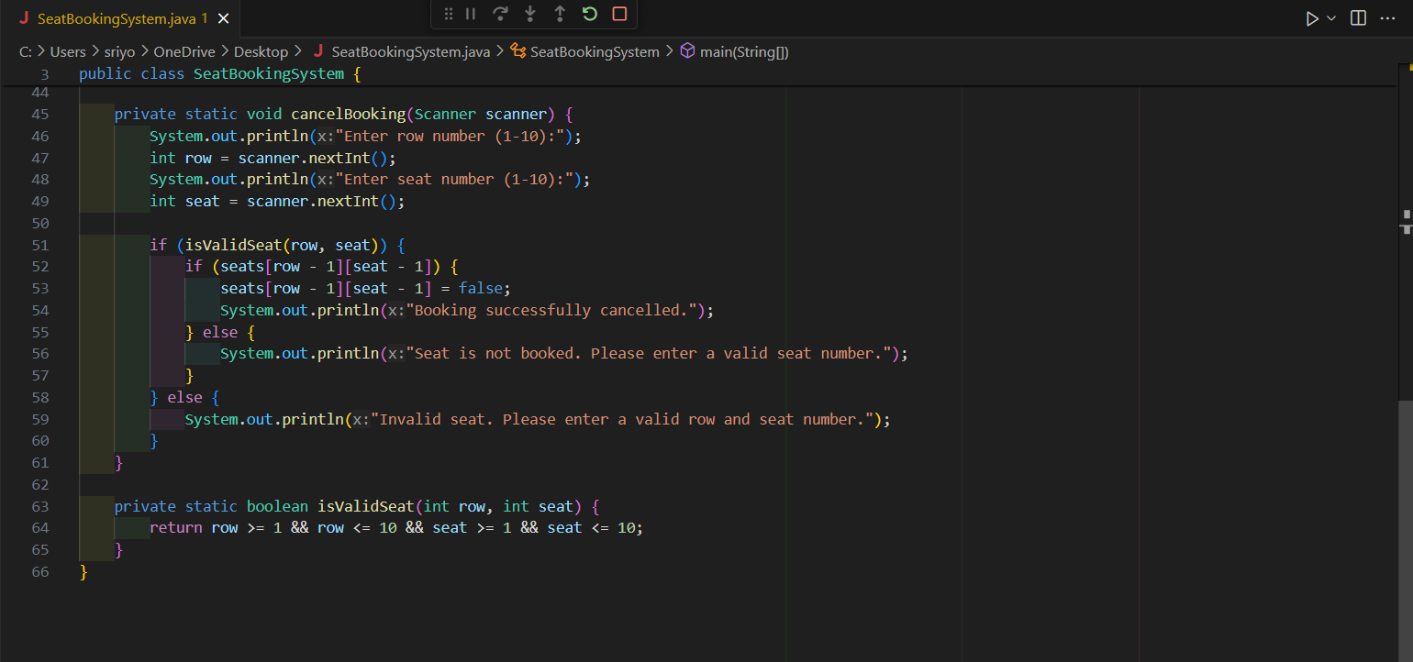

Slide 15
EXECUTION

Slide 16
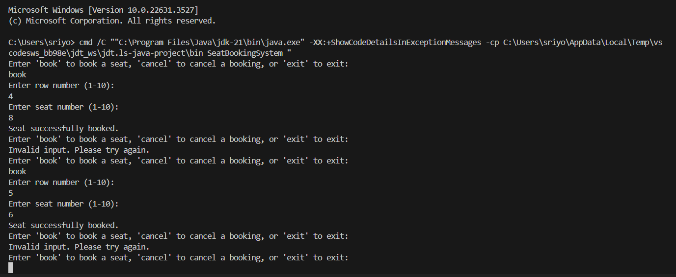
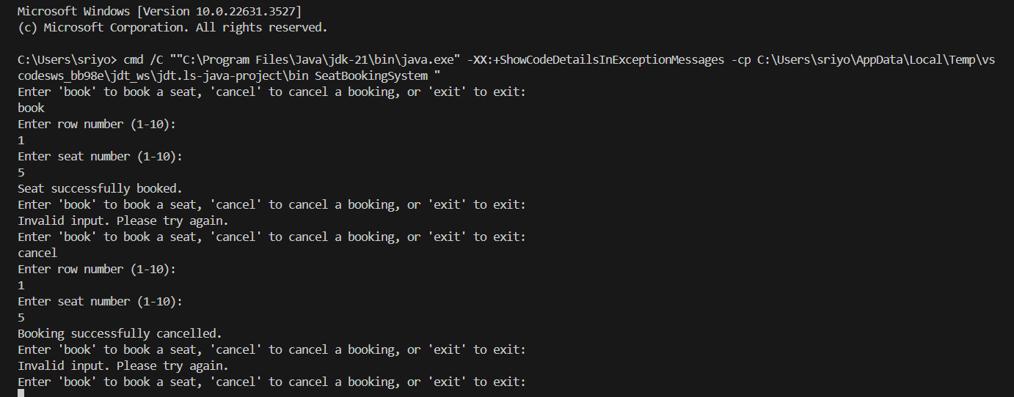
TO BOOK A SEAT
TO CANCEL A SEAT

Slide 17
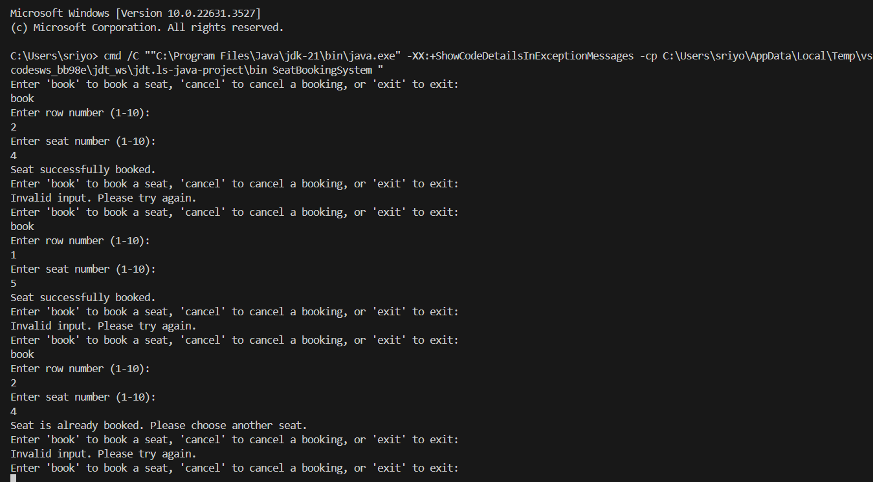
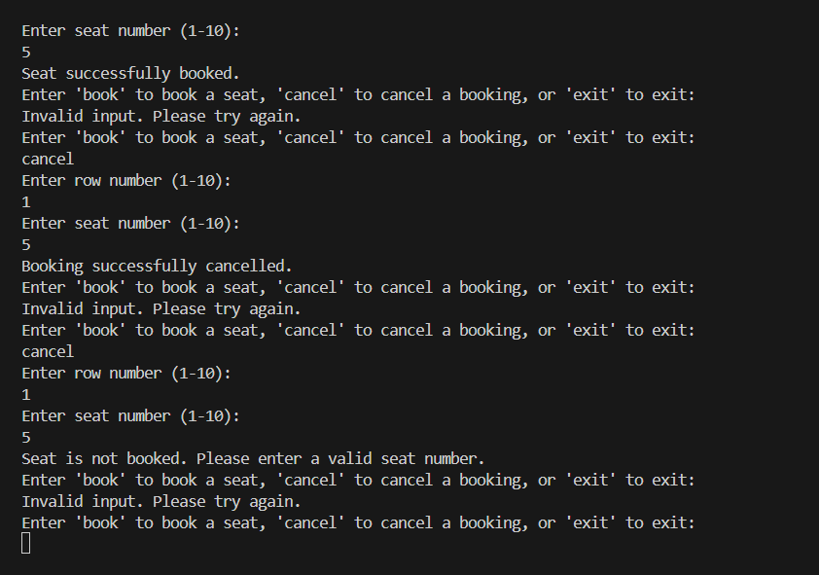
TO CHECK IF A SEAT HAS ALREADY BEEN BOOKED OR NOT
TO CHECK IF A SEAT HAS BEEN CANCELED OR NOT

Slide 18
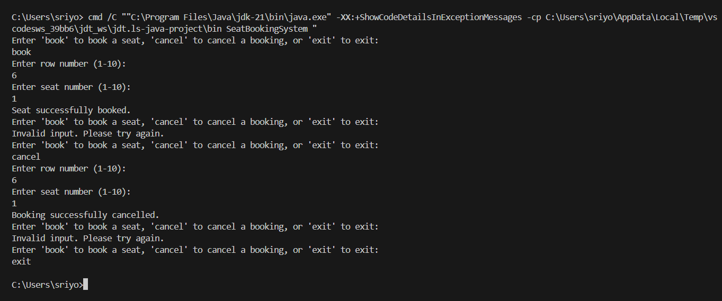
TO BOOK, CANCEL, AND EXIT THE BOOKING

Slide 19
PROJECT REPORT

Slide 20
The primary objective of this project is to revolutionize the stadium seat booking process by developing an advanced, Java-based system that tackles the challenges of efficient seat allocation.
The key goals of the project are:
Implement cutting-edge seat allocation strategies to enhance the overall user experience and optimize the booking process.
Create a robust and user-friendly system that simplifies the seat selection process for customers while maximizing the utilization of available seating capacity.
Leverage innovative algorithms and data structures to enable efficient real-time seat allocation, considering factors such as group bookings, seat preferences, and seating constraints.
Ensure scalability and performance to provide a seamless booking experience during peak periods.
Incorporate dynamic seat mapping and intelligent seat recommendation systems to offer a personalized and efficient booking experience for users.
Develop advanced seat allocation algorithms: The project will focus on designing and implementing efficient seat allocation algorithms that can intelligently assign seats based on user preferences, seat availability, and specific constraints.
Implement a user-friendly interface: The project will create an intuitive and easy-to-use booking interface that simplifies the seat selection process for customers.

Slide 21
THANK YOU

